Slide 1
Census and ACS
CP201A: September 6, 2015

Slide 2
Ground rules
Poster coming next week!
GSI Ground Rules
Treat your GSIs with kindness and respect
They’re students too
Appreciate that they have deadlines of their own
Give them space to be “students” – no asking questions about MOEs in the middle of hanging out at Happy Hour
I give the grades – they give constructive comments and feedback to help you learn

Slide 3
Case Study Field Trips: Look for Bcourses announcement
Wednesday, September 5: 3:30 – 5:30 pm: Adeline Corridor, Berkeley, Meet at Ashby BART
Thursday, September 6, 4:00 – 6:00 p.m.: 23rd Street, Richmond, Meet at Portumex, 721 23rd Street
Friday, September 7, 4:00 – 6:00 p.m.: Chinatown/Tenderloin, San Francisco, meet at Portsmouth Square, top level, Chinatown
Sunday, September 9, 2:00 – 4:00 p.m.: West/Downtown Oakland/MacArthur BART (on bikes), meet at West Oakland BART

Slide 4
Basic guidelines
You can choose your own neighborhood, especially if you’re familiar with/working in, a Bay Area neighborhood
If you are new to Bay Area, or to methods, highly recommend picking one of our designated neighborhoods, and using same census tract definitions as classmates
You will start working with case study data today in lab – IT’S JUST PRACTICE!!!! So you can work with the Tenderloin data for now and then choose your neighborhood later – you’ll duplicate some work but that’s GREAT for learning

Slide 5
Goals for today
Introduction to the Census and American Community Survey (ACS)
History of the Census and ACS
Geographic scales
Race and Ethnicity in the Census
Assignment 1

Slide 6
The census
Notes:
from Latin, applied to the registration of citizens and property in ancient Rome, usually for taxation, from censere ‘assess.

Slide 7
Census/ACS most important source of planning data
Used in many planning contexts
Housing Elements
Site analysis
Forecasting (Plan Bay Area)
Health Impact Assessments
Sustainability (or displacement) indices
Program eligibility, block grants
Controlling for neighborhood characteristics in regression studies

Slide 8
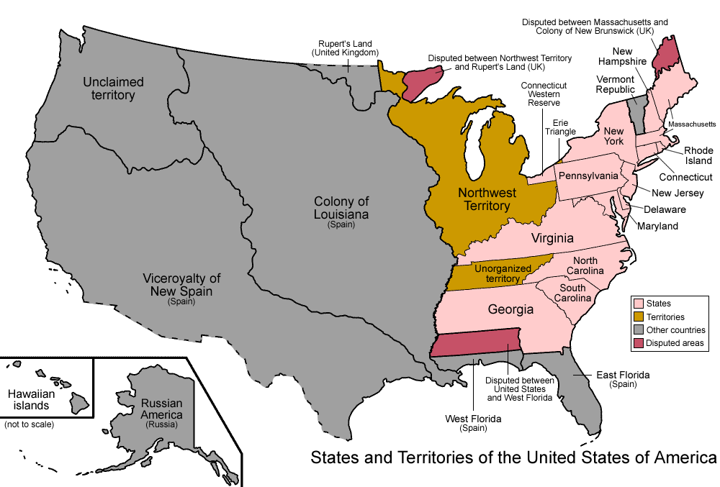
The Census: mandated by Article I, Section 2 of the Constitution
Notes:
1790 – 4 million population
The United States was the first country to call for a regularly held census. The categories allowed Congress to determine persons residing in the United States for collection of taxes and the appropriation of seats in the House of Representatives.
Representatives and direct Taxes shall be apportioned among the several States which may be included within this Union, according to their respective Numbers, which shall be determined by adding to the whole Number of free Persons, including those bound to Service for a Term of Years, and excluding Indians not taxed, three fifths of all other Persons. The actual Enumeration shall be made within three Years after the first Meeting of the Congress of the United States, and within every subsequent Term of ten Years, in such Manner as they shall by Law direct.

Slide 9
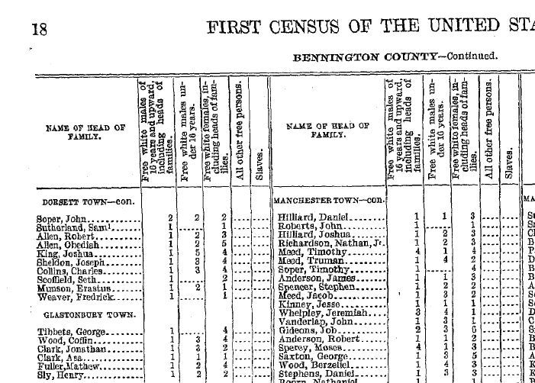
The 1790 Census
Notes:
"All other free persons" mostly meant free blacks, or African Americans who were not enslaved. It also included Native Americans and immigrants from Asia.

Slide 10
The Census: A Cultural Document
1900: Included incidents of deafness, blindness, insanity, juvenile delinquency
1910: Added questions about mines and quarries. First time questions were asked about nationality or mother tongue of foreign-born persons and their parents
1940: First time information was collected on housing
1960: First time census forms were mailed, the birth of the “long form” sample (SF3 and SF4)
1980: First time questions were asked about Hispanic origin of 100% of the population
1990: First time a household could indicate “same-sex” partnership
Notes:
Same sex starting in 1990, but still no option to indicate anything other than male/female
Income, but no information on assets
Third Wave 1880 - 1914
PUSH/PULL FACTORS: Immigrants came over to America for more job opportunities and freedom of religion.
IMMIGRANTS: Chinese, Japanese, and other Asian countries (migrated to the western states).
FACTS: -Over half of the operatives in steel, meat-packing, and mining were made up of immigrants. -In the 1910 census, foreign-born residents made up 15 percent of the U.S. population and 24 percent of the U.S. labor force. -By 1914, 1.2 million immigrants had entered the United States.
-Hispanics made up about one-half of the number of immigrants in the 1980s and early 1990s.

Slide 11
The 2000 Census (1980/1990)
Summary File 1 (SF 1 and SF 2 (provides detailed breakdowns by race/ethnicity) )
The “short form”
Count of people, households, housing units
Age, sex, race, Hispanic/Latino origin,
Owner/renter status
Family composition
Summary File 3 (SF 3 and SF 4)
The “long form”
Social, economic and housing characteristics compiled from a sample of approximately 19 million housing units (about 1 in 6 households)

Slide 12
2010 Census
100% count (more or less, under and over-counting)
People: demographic variables (persons, age, household relationships, race and ethnicity)
Housing: tenure and vacancy
THAT’S IT!!!!!

Slide 13
The American Community Survey (ACS)
More detailed info on people and housing is now contained in the ACS rather than the Census
Most people use Census/ACS interchangeably, since both are administered by Census
Replaces long form with a “rolling” sample of approx. 3 million housing units each year
Margins of error become critically important
A much smaller sample than the Census SF3

Slide 14
Understanding the “universe” of a variable
Persons
Persons for Whom the Poverty Status is Determined
Male
Female
Persons in the Labor Force
Households
Single Parent Households
Housing Units
Occupied Housing Units
Rental
Owned

Slide 15
Geographic Aggregation
The Census doesn’t release data about every person it collects information from
Instead, it provides two different Census/ACS data products
Geographically “aggregated” data, where the underlying survey information is used to develop measures for different places (e.g., neighborhoods, counties, states)
A sample of individual survey responses known as the Public Use Microdata Sample, or PUMS
To protect privacy, these data are not available at the neighborhood level, so tend to be used less by planners

Slide 16
Geographic scales

Slide 17
Key Census Building Blocks
National
State
County
Census Tract
Block Group
All of these geographies are nested, and are identified by a Federal Information Processing Standards (FIPS) code
California - 06
Alameda County - 001
Temescal - 401100
Block Group - 1
Unique FIPS: 060014011001
Notes:
San Francisco 75
Contra Costa 13

Slide 18
States

Slide 19
Counties

Slide 20
SF is City and County

Slide 21
Census Tracts

Slide 22
Block Groups

Slide 23
Understanding FIPS codes
Tract Number | The Full FIPS
226 | 060750(226)00
227.02 | 060750(22702)
614 | 060750(614)00

Slide 24
How do I find out what Census Tracts comprise a neighborhood?
Census Tools
American Factfinder
Geocoding API
Social Explorer
Access through the library website to get full functionality
Oskicat-Social Explorer
PolicyMap
Access through the library website to get full functionality
Oskicat-Policymap

Slide 25
Approach every other geography with caution!
Zip codes: change frequently, do not respect any census boundaries (including states)
Metropolitan Statistical Areas (MSAs): definition set by OMB, not Census, also change over time (and not only in Census years), can cross Census boundaries (including states!)
Notes:
Stay alert! OMB can, and does, add and subtract counties from metro and micro areas. For example, over time Walker County has been in, then out, then back in the Birmingham metro area.
Metro and micro areas can cross state boundaries. For example, Russell County, Alabama belongs to the Columbus, Georgia metro area. Quitman County, Georgia belongs to the Eufaula, Alabama micro area. The Auburn-Opelika metro area belongs to the Atlanta-Sandy Springs-Gainsville GA-AL combined statistical area.

Slide 26
Race/ethnicity

Slide 27
Making hispanics
UC Berkeley Sociologist Cristina Mora

Slide 28
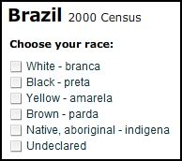
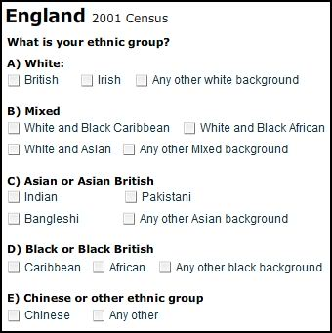
Race as social construct

Slide 29
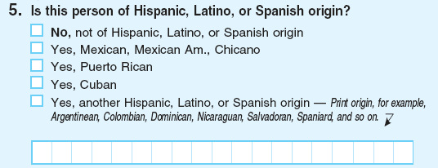
Ethnicity (2010)

Slide 30
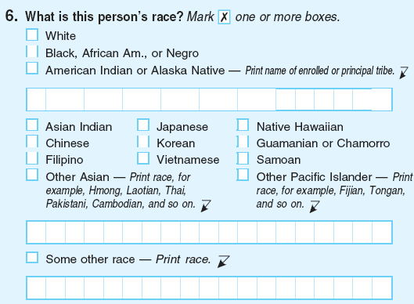
Race (2010)

Slide 31
Rule #1
You must, if you are describing the racial and ethnic composition of a neighborhood, use the following convention:
Non-Hispanic White
Black (non-Hispanic)
Asian (non-Hispanic)
Alaskan and Native American (non-Hispanic)
Hawaiian and Pacific Islander (non-Hispanic)
Hispanic
Unless, you are interested in exploring the complicated relationships between race/ethnicity or are interested in the experiences of a specific group – e.g., Hispanic Blacks

Slide 32
wrong!!!!!
Population Demographics, Alameda County, ACS (2013)
 | Population | Percent
White | 700,110 | 45.6
Black or African American | 185,467 | 12.1
American Indian and Alaska Native | 8,919 | 0.6
Asian | 411,240 | 26.8
Native Hawaiian/Pacific Islander | 12,579 | 0.8

Slide 33
Use “Hispanic or Latino Origin by race” table (P9 or B03002)
Population Demographics, Alameda County, ACS (2013)
 | Population | Percent
Non-Hispanic White | 517,776 | 33.7
Black or African American | 181,315 | 11.8
Hispanic | 345,847 | 22.5
American Indian and Alaska Native | 4,484 | 0.3
Asian | 408,556 | 26.6
Native Hawaiian/Pacific Islander | 12,230 | 0.8

Slide 34
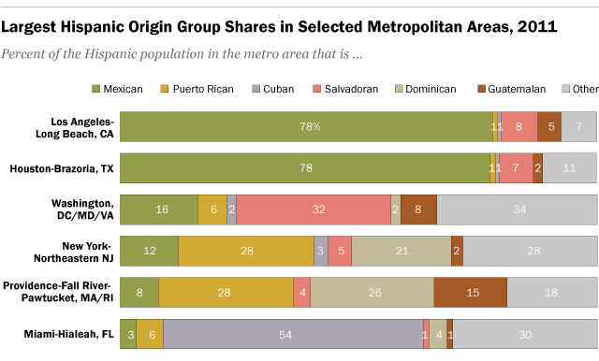
In Some cases, you will choose a different approach

Slide 35
Assignment 1

